Slide 1
Network Data Analysis Lab Project 9: Traffic Forecasting
Team: Group 8
Presenters: Alexander Stefitz, Enrico Gregorini, Lorenzo Prada
Academic Year: 2022/2023

Slide 2
Introduction
Network Traffic changes quickly during the day
Processing and transporting resources can be scaled
A good traffic prediction may save a lot of resources
How do we perform a good traffic prediction and how can we use it to save resources?
Machine learning algorithms
Automatically turn on/off interfaces for traffic allocation based on the predictions

Slide 3

Dataset – Info
GÉANT is the research network that carries traffic between universities and research institutes in Europe
GÉANT is composed of 23 routers connected with 38 physical links
GÉANT uses SONET technology to multiplex traffic with different bitrates into one optical signal
Channel with the smallest bitrate that can be created in SONET is 50 Mb/s
Each file in the dataset describes total traffic in kb/s between pairs of routers
Dataset includes 2941 files: traffic at 15 minutes intervals for 1 month

Slide 4
Dataset – Files
In total there are 2941 .xml files, each containing the amount of traffic measured in the previous 15 minutes
The measures has been taken from 01/01/2005 to 31/01/2005 included
We do not have any topological information about the network
We cannot assume any other information except the ones provided in the .xml files
<IntraTM ASID="20965"> <src id="12"> <dst id="12">305258.2222</dst> <dst id="13">28801.8756</dst> <dst id="19">4077.1556</dst> <dst id="23">166.9067</dst> <dst id="8">1812.3022</dst> </src> <src id="13"> <dst id="12">37182.8622</dst> <dst id="19">20624.0267</dst> <dst id="23">818.2044</dst> <dst id="8">10468.6044</dst> </src> </IntraTM>

Slide 5
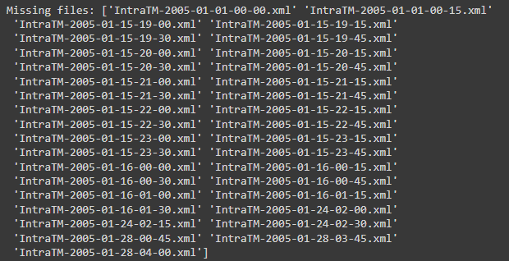
Dataset – Missing Files
1 [day] = 24 [h] = 96 [sample a day]
31 [days] ⇒ 31*96 = 2976 [expected sample] != 2941 [dataset sample]
There are 35 missing files
Not much compared to the amount of data we have
We filled missing values with NaNs
All .xml are parsed and handled as NumPy array

Slide 6
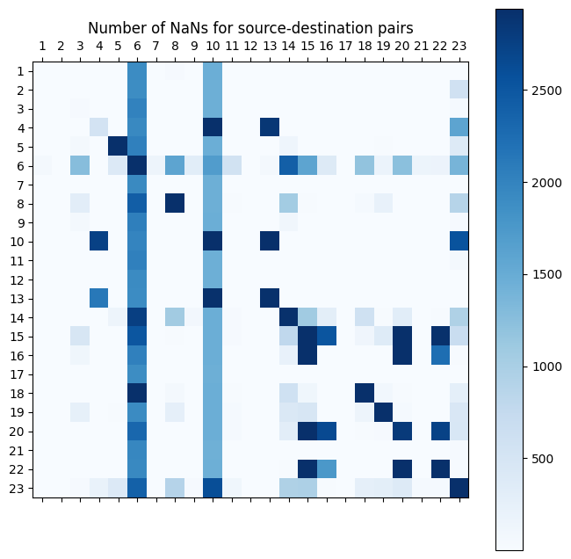
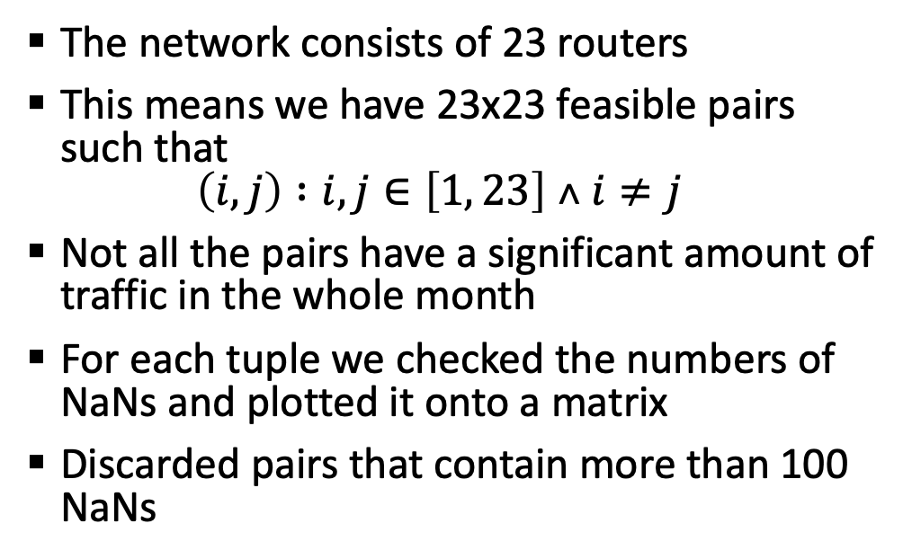
Dataset – Missing Data

Slide 7
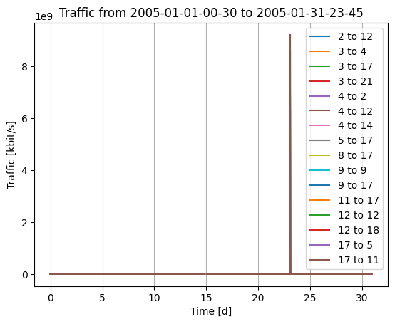
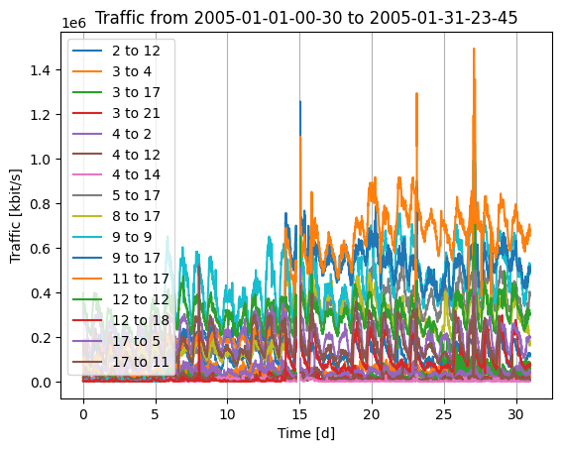
Data – Corrupted File
Noticed that there are some huge outliers at a specific point (in the order of 10⁹)
So, we plotted the traffic trace of pairs containing that data
They all overlap and overwhelm other data by a significant amount
Since this is infeasible, especially in 2005, we removed these values and plotted the trace again
The second graph looks as expected
Since all that values come from the same file, we decided to classify that file as corrupted and discard it, replacing its values with NaNs

Slide 8
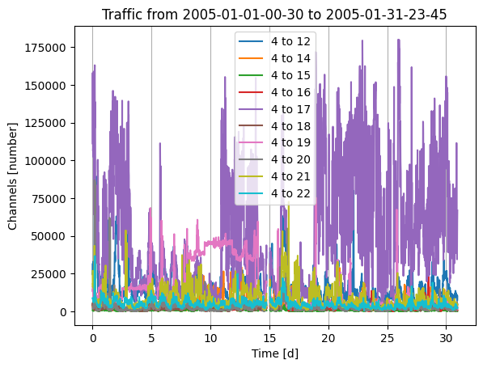
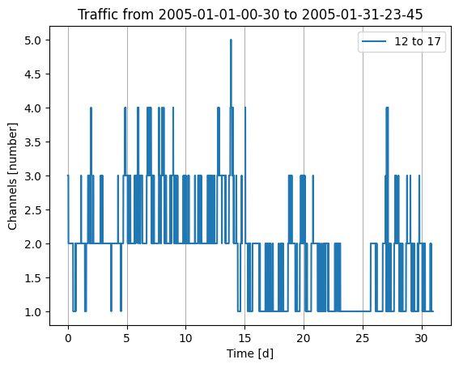
Pairs Selection – Graphical check
After discard pairs with more than 100 NaNs we have 398 pairs
We did a graphical check of the time series
This is useful to get an idea of the traffic shape, the amount of data is too big to decide only on graphical evidence

Slide 9
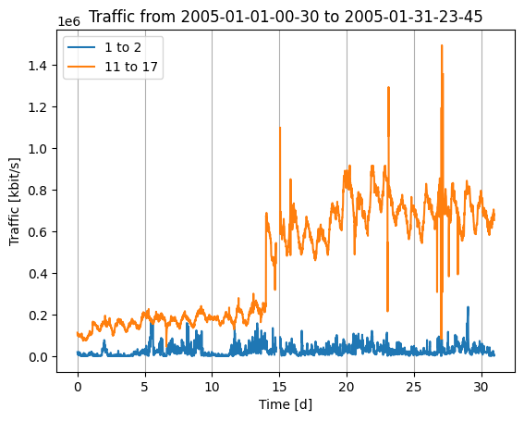
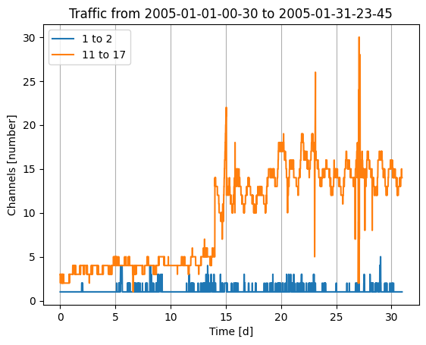
Pairs Selection – Variance check
We then checked the variance of the channels, ignoring the NaNs we added
More than half of pairs have 0 variance, which means constant channels over time
So, we manually checked the variances of the tuples and decide to discard tuples which have a variance < 0.1
To decide this threshold we plotted different traffic traces with a known variance and looking at the shape of the graph we concluded the following
Everything below 0.01 is almost constant traffic, so it can be discarded
Everything above 1 is very nice
Looking at the shape of 0.01 graphs and 1 graphs we concluded that 0.1 could be a reasonable threshold
In the end, 52 remaining candidate pairs, which is a very reasonable amount of traffic for model fitting

Slide 10
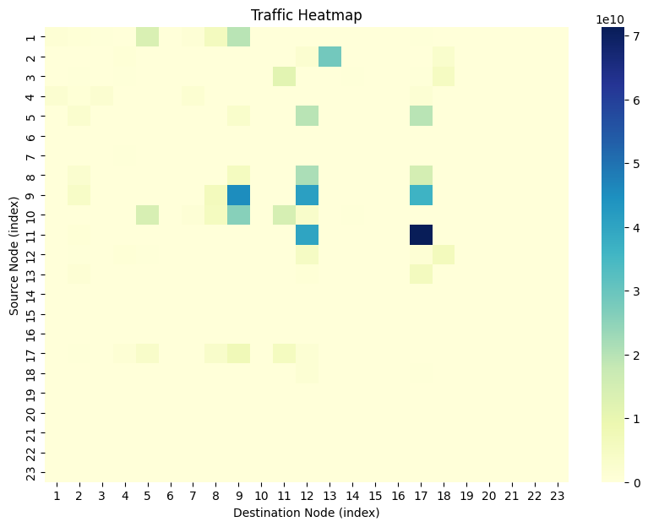
Pairs Selection – Filling the NaNs
The remaining 52 pairs still contains a few NaNs
We used NumPy.interp() to make a linear interpolation of the missing values
The heatmap shows the traffic we got after filtering and reshaping for each tuple

Slide 11
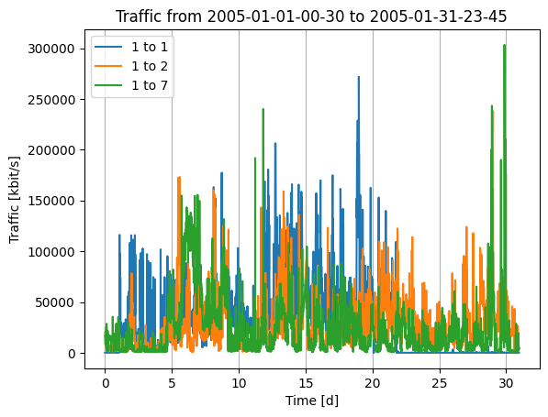
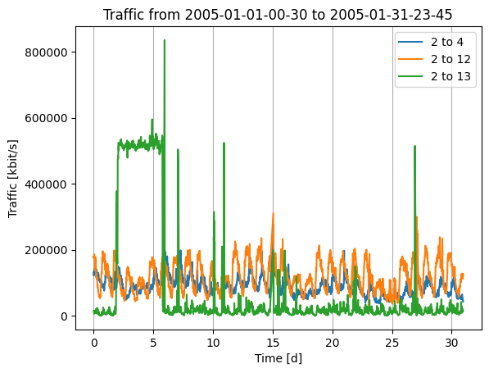
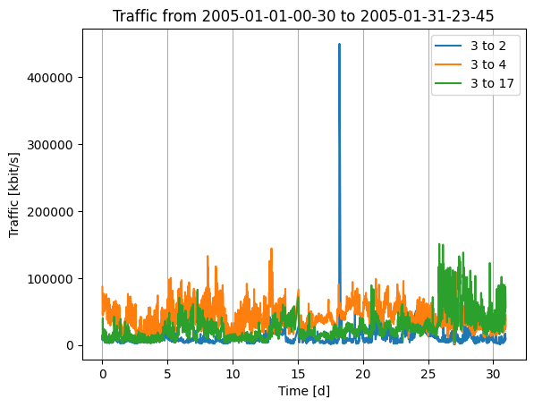
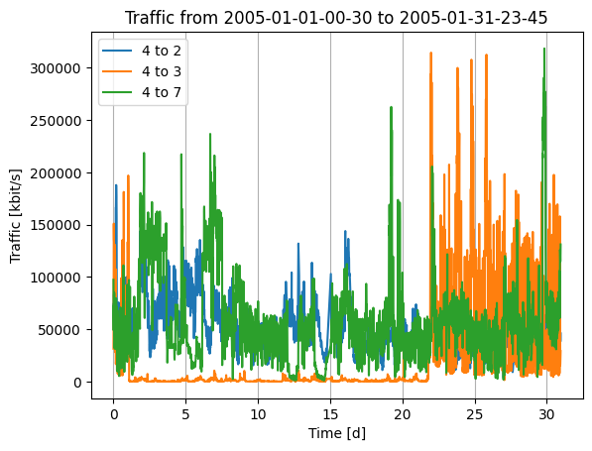
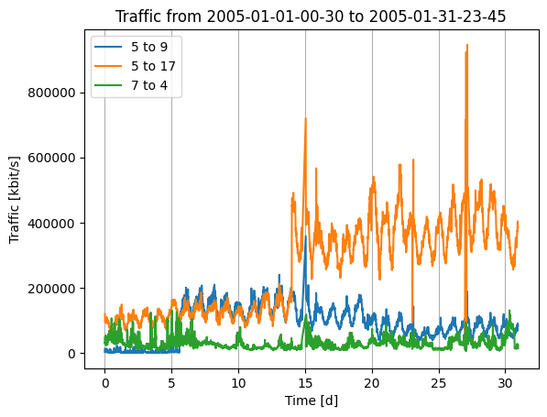
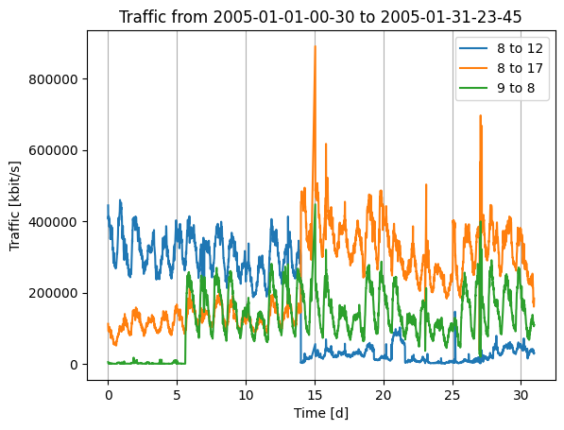
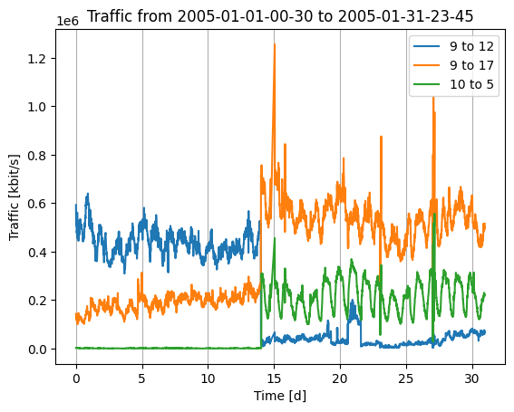
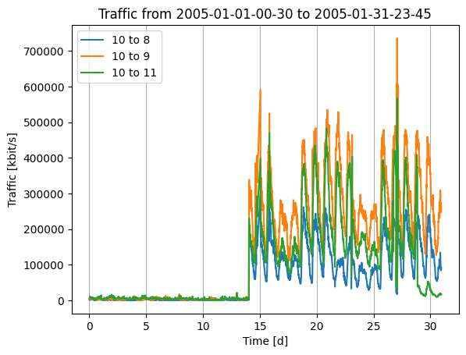
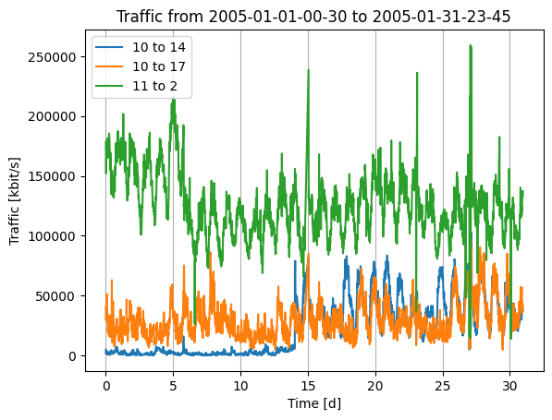
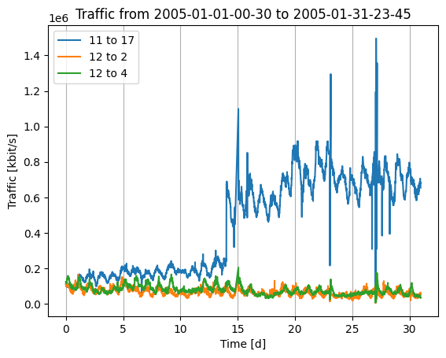
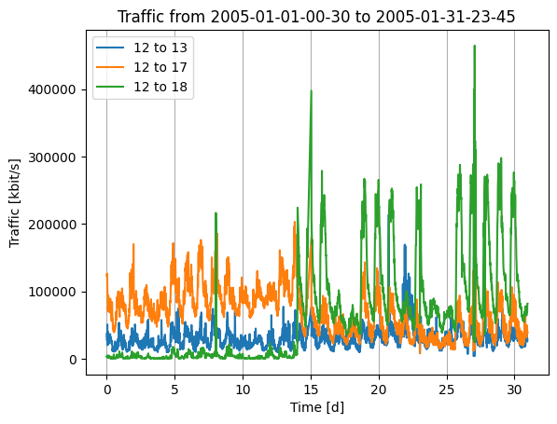
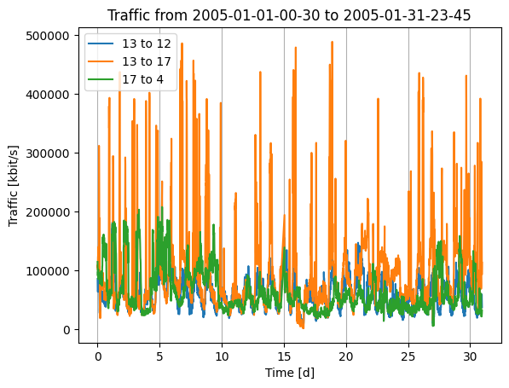
Pairs Selection – Overview

Slide 12
Traffic Prediction – ML algorithms
LSTM – Long Short-Term Memory ←
Feature-based approach:
LinReg – Linear Regression
ANN – Artificial Neural Network

Slide 13
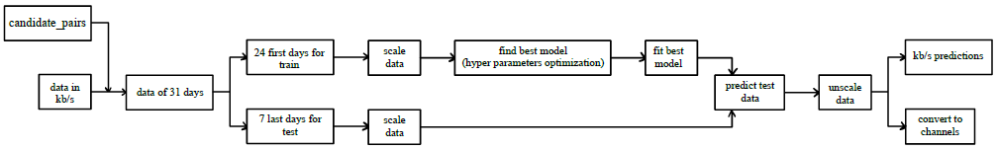
LSTM – kb/s Prediction
We got a subset of source-destination pairs called candidate_pairs
Each one contains traffic for 31 days
First 24 days are taken as train set and last 7 as test set
This is done for each candidate pair and train and test split are concatenated
Used train set to find scaling parameters, also used them for test data

Slide 14
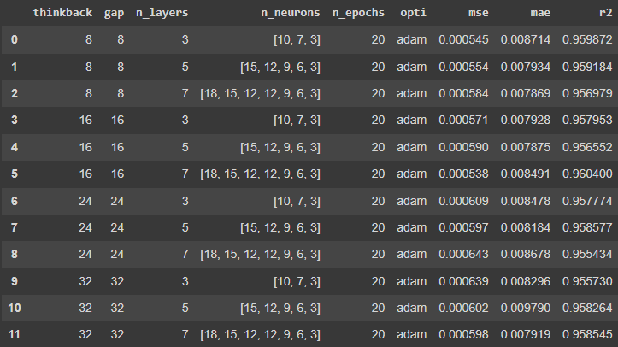
LSTM – Model Fitting
In order to find the best model, we tried different parameters combination using a grid search
We used the model that obtained the highest MSE, MAE and R² score.
LSTM kb/s Best Model
gap | [16]
n_epochs | [50]
n_layers | [7]
n_neurons | [[18, 15, 12, 12, 9, 6, 3]]
opti | [‘adam’]
thinkback | [16]

Slide 15
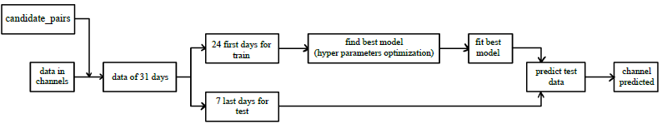
LSTM – Channels Prediction
The incoming data in this case are directly the channels
Best model is obtained in the same way as before (it comes out they are the same)
Channels required are the prediction’s results

Slide 16
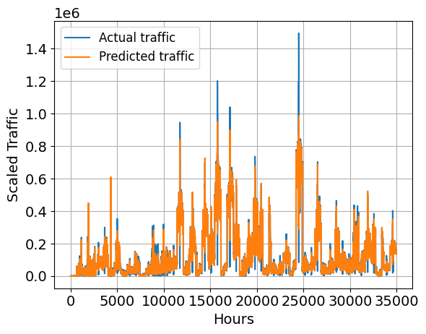
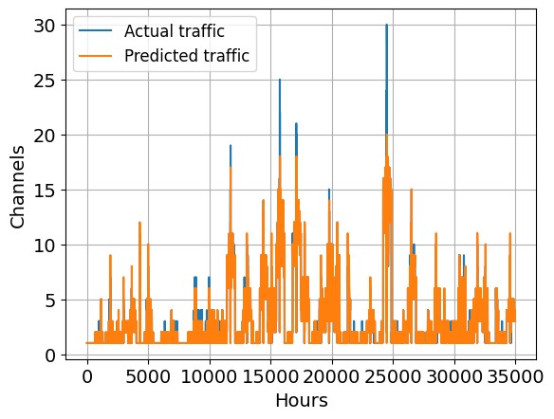


LSTM – kb/s vs Channel
LSTM Kb/s
over | 2712
n_over | 2147
under | 3757
n_under | 3057
incorrect ratio | 0.1489
mse | 0.0005379
mae | 0.0084906
r2 | 0.9604
LSTM Kb/s
over | 3017
n_over | 2475
under | 3708
n_under | 2811
incorrect ratio | 0.1512
mse | 0.494763
mae | 0.19245
r2 | 0.9448
[Kbps]

Slide 17
Traffic Prediction – ML algorithms
LSTM – Long Short-Term Memory
Feature-based approach: ←
LinReg – Linear Regression
ANN – Artificial Neural Network

Slide 18
Features
These are the features extracted, scaled and used to train the LinReg model
Var name | Type | Description
src | int [1,23] | Index of the source node
dst | int [1,23] | Index of the destination node
day | int [1,7] | Day of the week
working | bool | True if it is a working day, else false
hour | Int [0,24] | Hour of day at which traffic has ben measured
prev_hour | int | Cumulative traffic of the previous hour
prev12_hours | int | Cumulative traffic of the previous 12 hours
prev_day | int | Cumulative traffic of the previous day

Slide 19
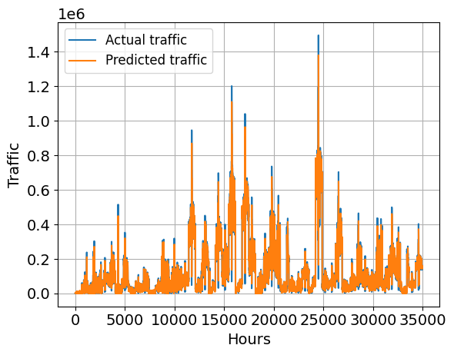
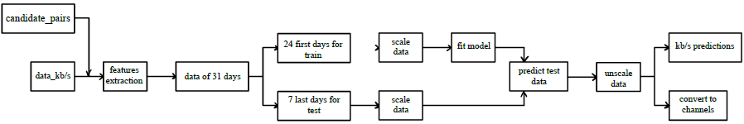
LinReg – kb/s Prediction
From all the data and the pairs we chosen in the initial part we extract the features and obtain the dataset
Dataset is split in train (first 24 days) and test (last 7 days) set
Scale the train and test set using MinMaxScaler
Fit the Linear Regression model with train set
Predict the test set
Unscale the data
Obtain the prediction in terms of kbit and then converted into channels
[Kbps]

Slide 20
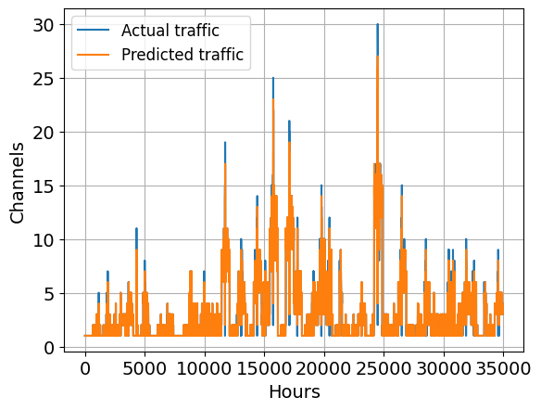
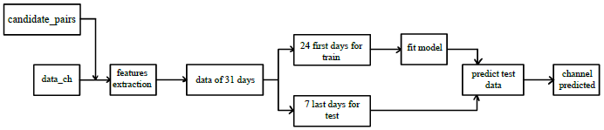
LinReg – Channels Prediction
Build and fit the model with the data referring to channels.
Only use unscaled dataset.
The steps are basically the same as before but here the model predicts directly the number of channels required to manage the traffic.

Slide 21
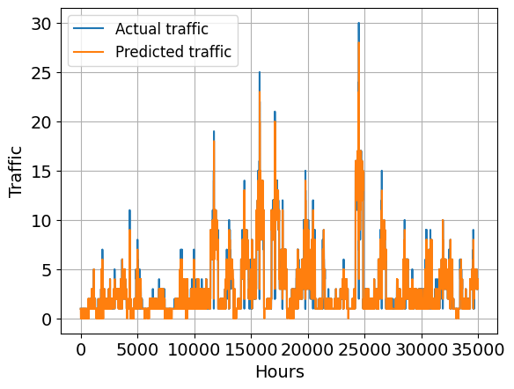

LinReg – kb/s vs Channels
LinReg Kb/s
over | 5939
n_over | 4690
under | 4940
n_under | 3987
incorrect ratio | 0,24831
mse | 0,69966
mae | 0,31133
r2 | 0,92199
LinReg Channels
over | 5460
n_over | 4129
under | 5167
n_under | 4161
incorrect ratio | 0,23724
mse | 0,69583
mae | 0,30412
r2 | 0,92241
Channels

Slide 22
ANN – Hyperparameters Optimization
ANN hyperparameters are chosen using a grid search over a set of parameters defined in a parameters grid (shown below)
The best ones in terms of MSE and R2 are chosen in order to predict the traffic of test set
Finally, the best ANN model is built and fit with 100 epochs in order to obtain better results
ANN parameters grid
Layers | 3, 5, 7
Neurons | [15,10,5], [21,18,15,12,9], [24,21,18,15,12,9,6]
Activation | ‘sigmoid’, ‘relu’
Epochs | 20
ANN best parameters
Layers | 7
Neurons | [24,21,18,15,12,9,6]
Activation | ‘relu’
Epochs | 20
Grid search

Slide 23

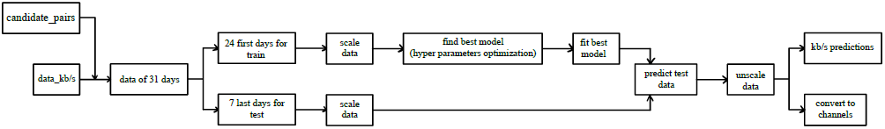
ANN – kb/s Prediction
From all data and the pairs we chose initially we extract the features and obtain the dataset
Dataset is split in train (first 24 days) and test (last 7 days) set
Scale the train and test set using MinMaxScaler
Optimize the model
Predict the test set
Unscale the data
Obtain the prediction in terms of kbit and then converted into channels
[Kbps]

Slide 24
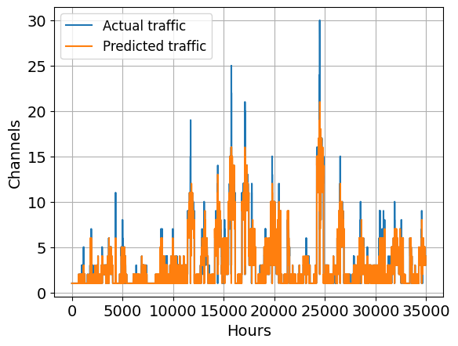
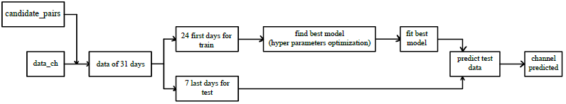
ANN – Channel Prediction
As we did with linear regression when we build our model with the data referring to channels.
We only use unscaled dataset.
The steps are basically the same as before but here the model predicts directly the number of channels required to manage the traffic.

Slide 25
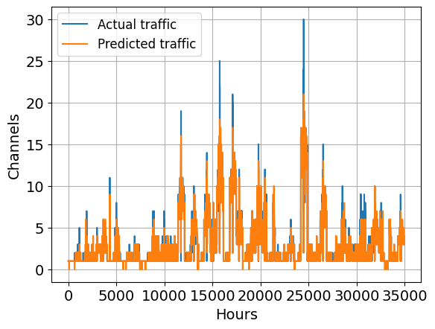
ANN – kb/s vs Channel
ANN kb/s
over | 5452
n_over | 4196
under | 4553
n_under | 3700
incorrect ratio | 0,22596
mse | 0,65714
mae | 0,28632
r2 | 0,92673
ANN Channels
over | 5366
n_over | 4051
under | 5062
n_under | 4227
incorrect ratio | 0,23689
mse | 0,67113
mae | 0,29842
r2 | 0,92517

Slide 26
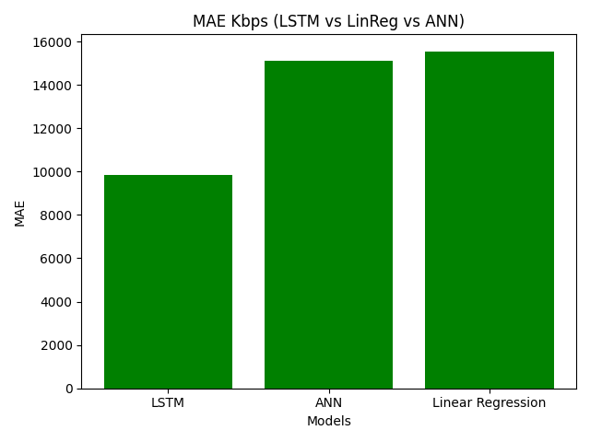
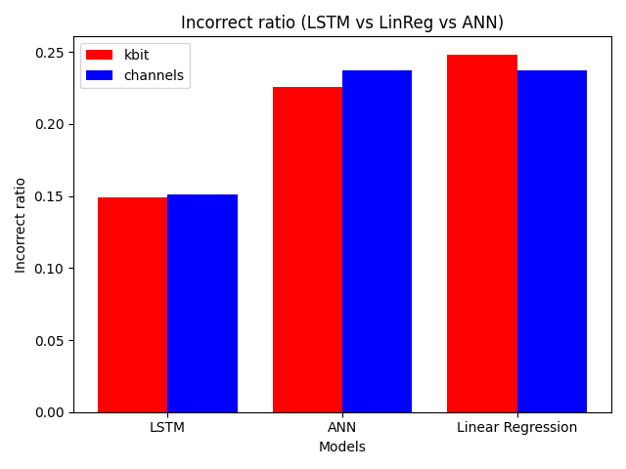
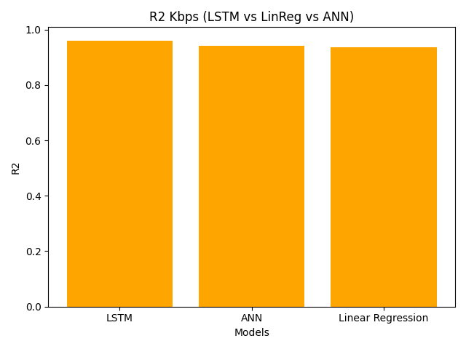
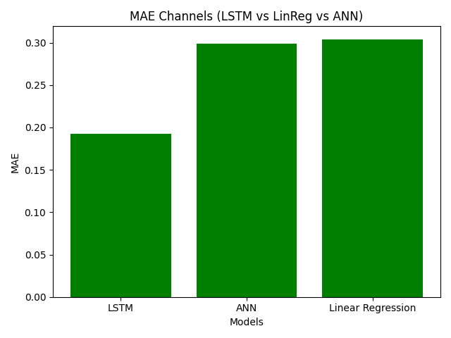
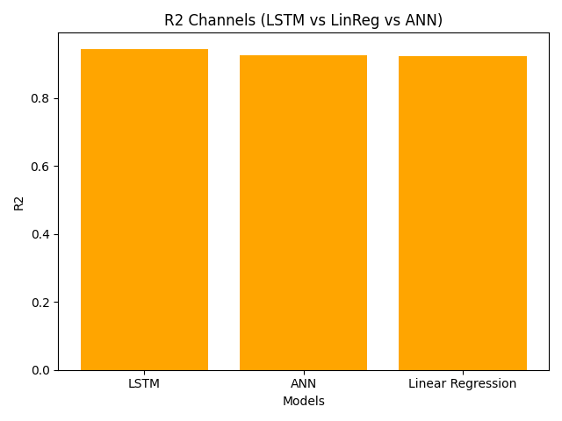
Comparison: MAE - Incorrect Ratio – R2
Results are averaged across 52 src-dst pairs
LSTM performs way better than ANN and LinReg
Difference between predicting kb/s and predicting channels smaller than expected
For LSTM and ANN it’s better to predict traffic and then convert it to channels
For LinReg it is better to predict directly channels

Slide 27
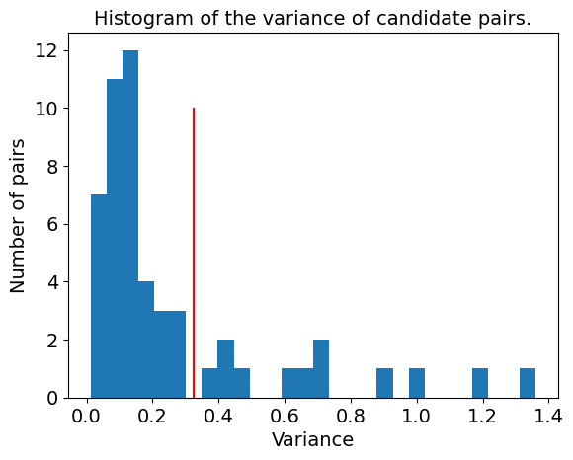
Transfer Learning – Different Approach
Until now we trained our models using the first 24 days of the time series and used the last 7 to evaluate it (of the whole candidate pairs)
Now the model will be trained on the entire series of a part of the 52 candidate pairs, and tested on the remaining pairs
We split the candidate pairs in 2 groups
Train on low variance couples
Test on high variance couples
We do only consider LSTM

Slide 28
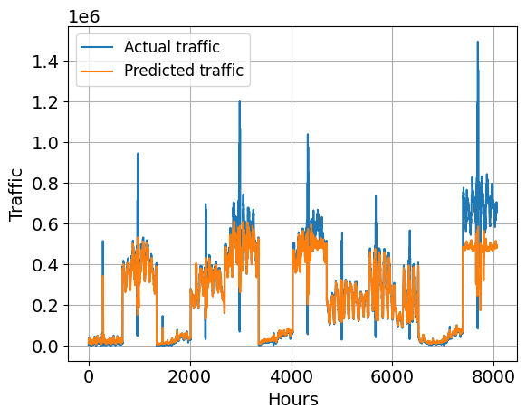
Transfer Learning – LSTM Predictions
[Kbps]
It follows more or less the same path
It performs worse
It does not predict high values

Slide 29
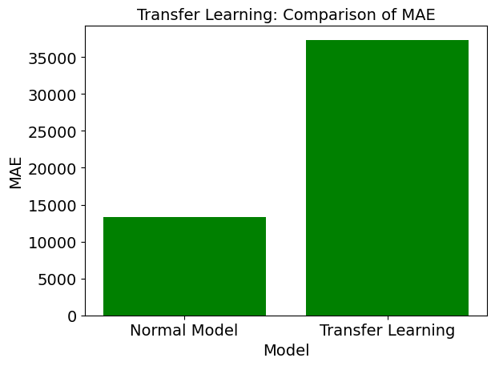
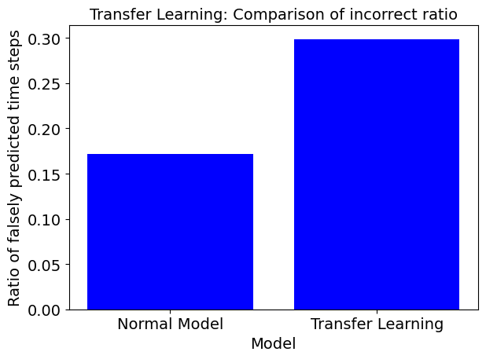
Transfer Learning – Comparison
Results are averaged across 52 source-destination pairs
For transfer learning only channels-predicting models have been used

Slide 30
Conclusions
LSTM performs way better than ANN and LinReg
LSTM took about 10 hours to train and fit, ANN 30 minutes. So, in some cases ANN could be a better choice
LinReg took some seconds to train and it is the only one that has higher results in predicting directly channels
In some scenarios where data availability is limited, transfer learning could be a good choice and prove to be very useful.
While transfer learning may not always deliver exceptional performance, the overall results are acceptable and demonstrate its practical value.

